Slide 1

Movie Recommendation System using Artificial Intelligence Techniques
Prepared by:
Pranav Pratheek Malleboyina (A04323794)
Sri Kalyan Reddy Akiti (A04318423)

Slide 2

Introduction
With so many movies available on streaming platforms, finding the right one can be overwhelming. This project introduces a smart Movie Recommendation System that uses Artificial Intelligence to make movie discovery simple and personalized.
The Problem: Too many choices make picking a movie hard.
The Solution: AI-powered recommendations tailored to what users like.
The Impact: Saves time, improves enjoyment, and boosts engagement.
Vision: To make finding movies easy and enjoyable by matching user preferences with vast movie libraries.

Slide 3

Motivation
In today’s digital landscape, where users face an overwhelming influx of information, effective content recommendation systems are essential for enhancing user engagement on digital platforms.
Movie recommendation systems, prominently featured on platforms like Netflix, Amazon Prime, and Hulu, play a critical role in improving user experience by offering personalized movie suggestions.
These systems not only enhance user satisfaction but also drive increased interaction and retention on the platform. Let us explore the various approaches that power the process of movie recommendation.

Slide 4

Popular Approaches
Content-Based Filtering: Recommends based on item attributes and user preferences.
Collaborative Filtering: Suggests using patterns of user-item interactions.
Hybrid System: Combines content-based and collaborative filtering.
Deep Learning Systems: Leverages neural networks for complex patterns.
RNNs: Predicts user behavior based on sequential data.

Slide 5

Challenges
Flask Inefficiency: Flask struggles with handling concurrent user requests at scale.
Cold-Start Problem: Difficulty in recommending for new users or items with no data.
Model Overhead: Real-time computations for large datasets cause performance issues.

Slide 6

System Architecture
The Movie Recommendation System processes data from movies.csv and ratings.csv, cleanses it, and stores it as pickle files for efficient use. It uses TF-IDF vectorization and cosine similarity to generate personalized recommendations based on user queries. The system is built with Flask for the backend and HTML/Bootstrap for the frontend, ensuring a scalable, real-time, and user-friendly experience.

Slide 7

Chosen Approach
The chosen approach combines content-based filtering and cosine similarity to recommend movies based on genres and user preferences. It utilizes TF-IDF vectorization to convert movie metadata into numerical features, enabling efficient similarity computations. This hybrid method ensures personalized, accurate, and scalable recommendations in real time.

Slide 8

Datasets
movies.csv:
Contains metadata about movies, including:
movieId: A unique identifier for each movie.
title: The movie name along with its release year.
genres: A list of genres associated with each movie (e.g., Action, Comedy).
ratings.csv:
Provides user interaction data, including:
userId: A unique identifier for each user.
movieId: Links ratings to movies in movies.csv.
rating: User-assigned rating (scale of 0.5 to 5).
timestamp: The time when the rating was given.
These datasets form the foundation of the recommendation system, enabling both content-based and collaborative filtering techniques.

Slide 9
Project Demo
I will show you the process
Input Query: Users enter a genre or keyword to get personalized recommendations.
Backend Processing: The system calculates cosine similarity and ranks results dynamically.
Output Display: Recommendations are shown with title, genre, rating, and release year.

Slide 10
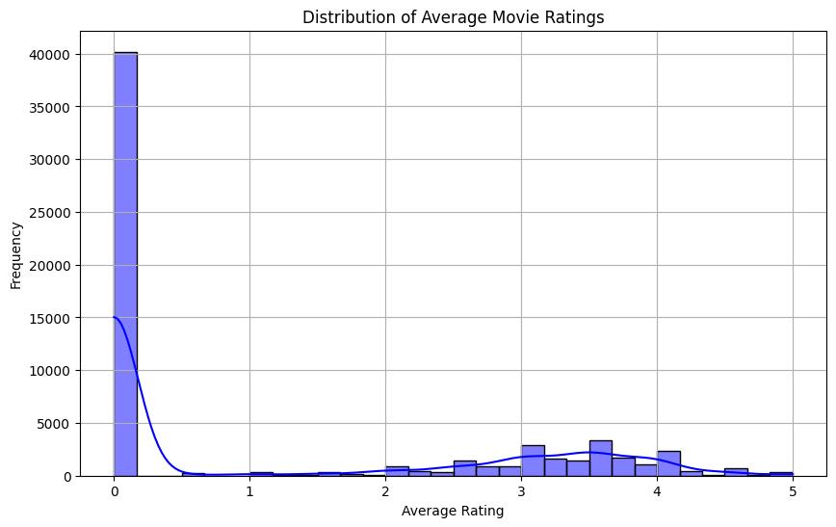
Graphical Representation

Slide 11
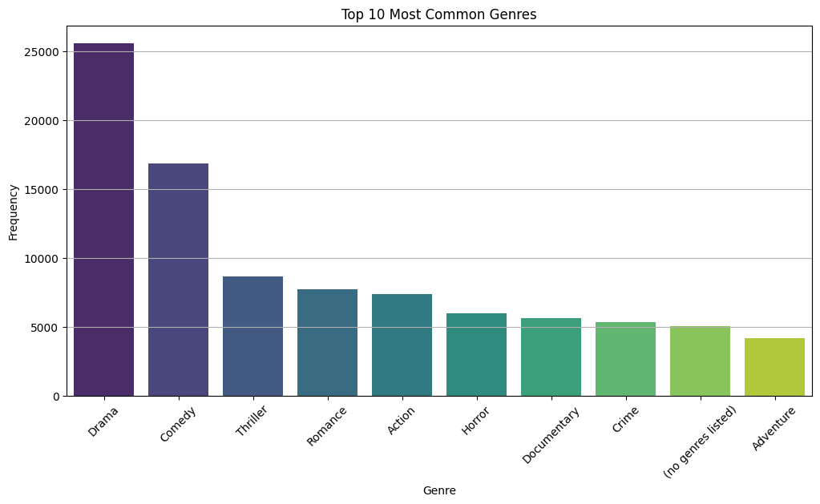

Slide 12
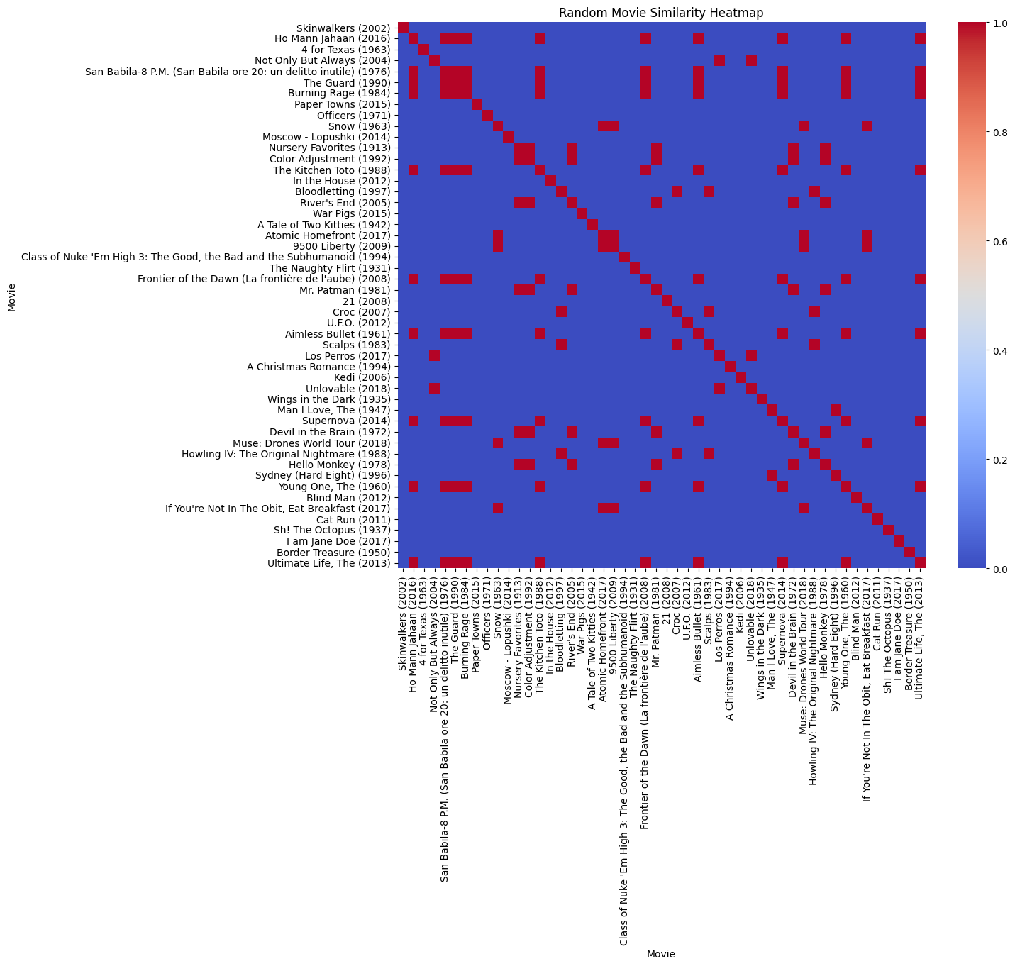

Slide 13
Future Improvements
Incorporate Collaborative Filtering: Combine user-item interaction data with the current content-based approach for more diverse recommendations.
Real-Time Adaptation: Implement reinforcement learning to refine recommendations dynamically based on user feedback.
Explainable AI: Add features to explain why a particular movie is recommended, improving transparency and user trust.

Slide 14

Conclusion
Personalized Suggestions: Uses AI techniques to deliver accurate and user-focused movie recommendations.
Seamless Integration: Combines preprocessing, backend logic, and a user-friendly interface for a robust system.
Future Potential: Supports enhancements like collaborative filtering and explainable AI for better engagement.

Slide 15
References
Paul Resnick, Neophytos Iacovou, Mitesh Suchak, Peter Bergstrom, and John Riedl. Grouplens: An open architec- ture for collaborative filtering of netnews. pages 175–186, 1994.
Badrul Sarwar, George Karypis, Joseph Konstan, and John Riedl. Item-based collaborative filtering recommendation algorithms. pages 285–295, 2001.
Michael J. Pazzani and Daniel Billsus. Content-based recommendation systems. pages 325–341, 2007.
Robin Burke. Hybrid recommender systems: Survey and experiments. volume 12, pages 331–370, 2002.
H. Wang, N. Wang, and D.-Y. Yeung. Collaborative deep learning for recommender systems. pages 1235–1244, 2015.
Xiangnan He, Lizi Liao, Hanwang Zhang, Liqiang Nie, Xia Hu, and Tat-Seng Chua. Neural collaborative filtering. pages 173–182, 2017.
Xiaohui Zhao, Hongwei Xia, Jiliang Tang, Xiang Song, Baoying Zhang, and Qiaozhu Mei. Deep reinforcement learning for recommendation systems. pages 1525–1533, 2017.

Slide 16

Questions/ Feedback

Slide 17

Thank You!

